Slide 1
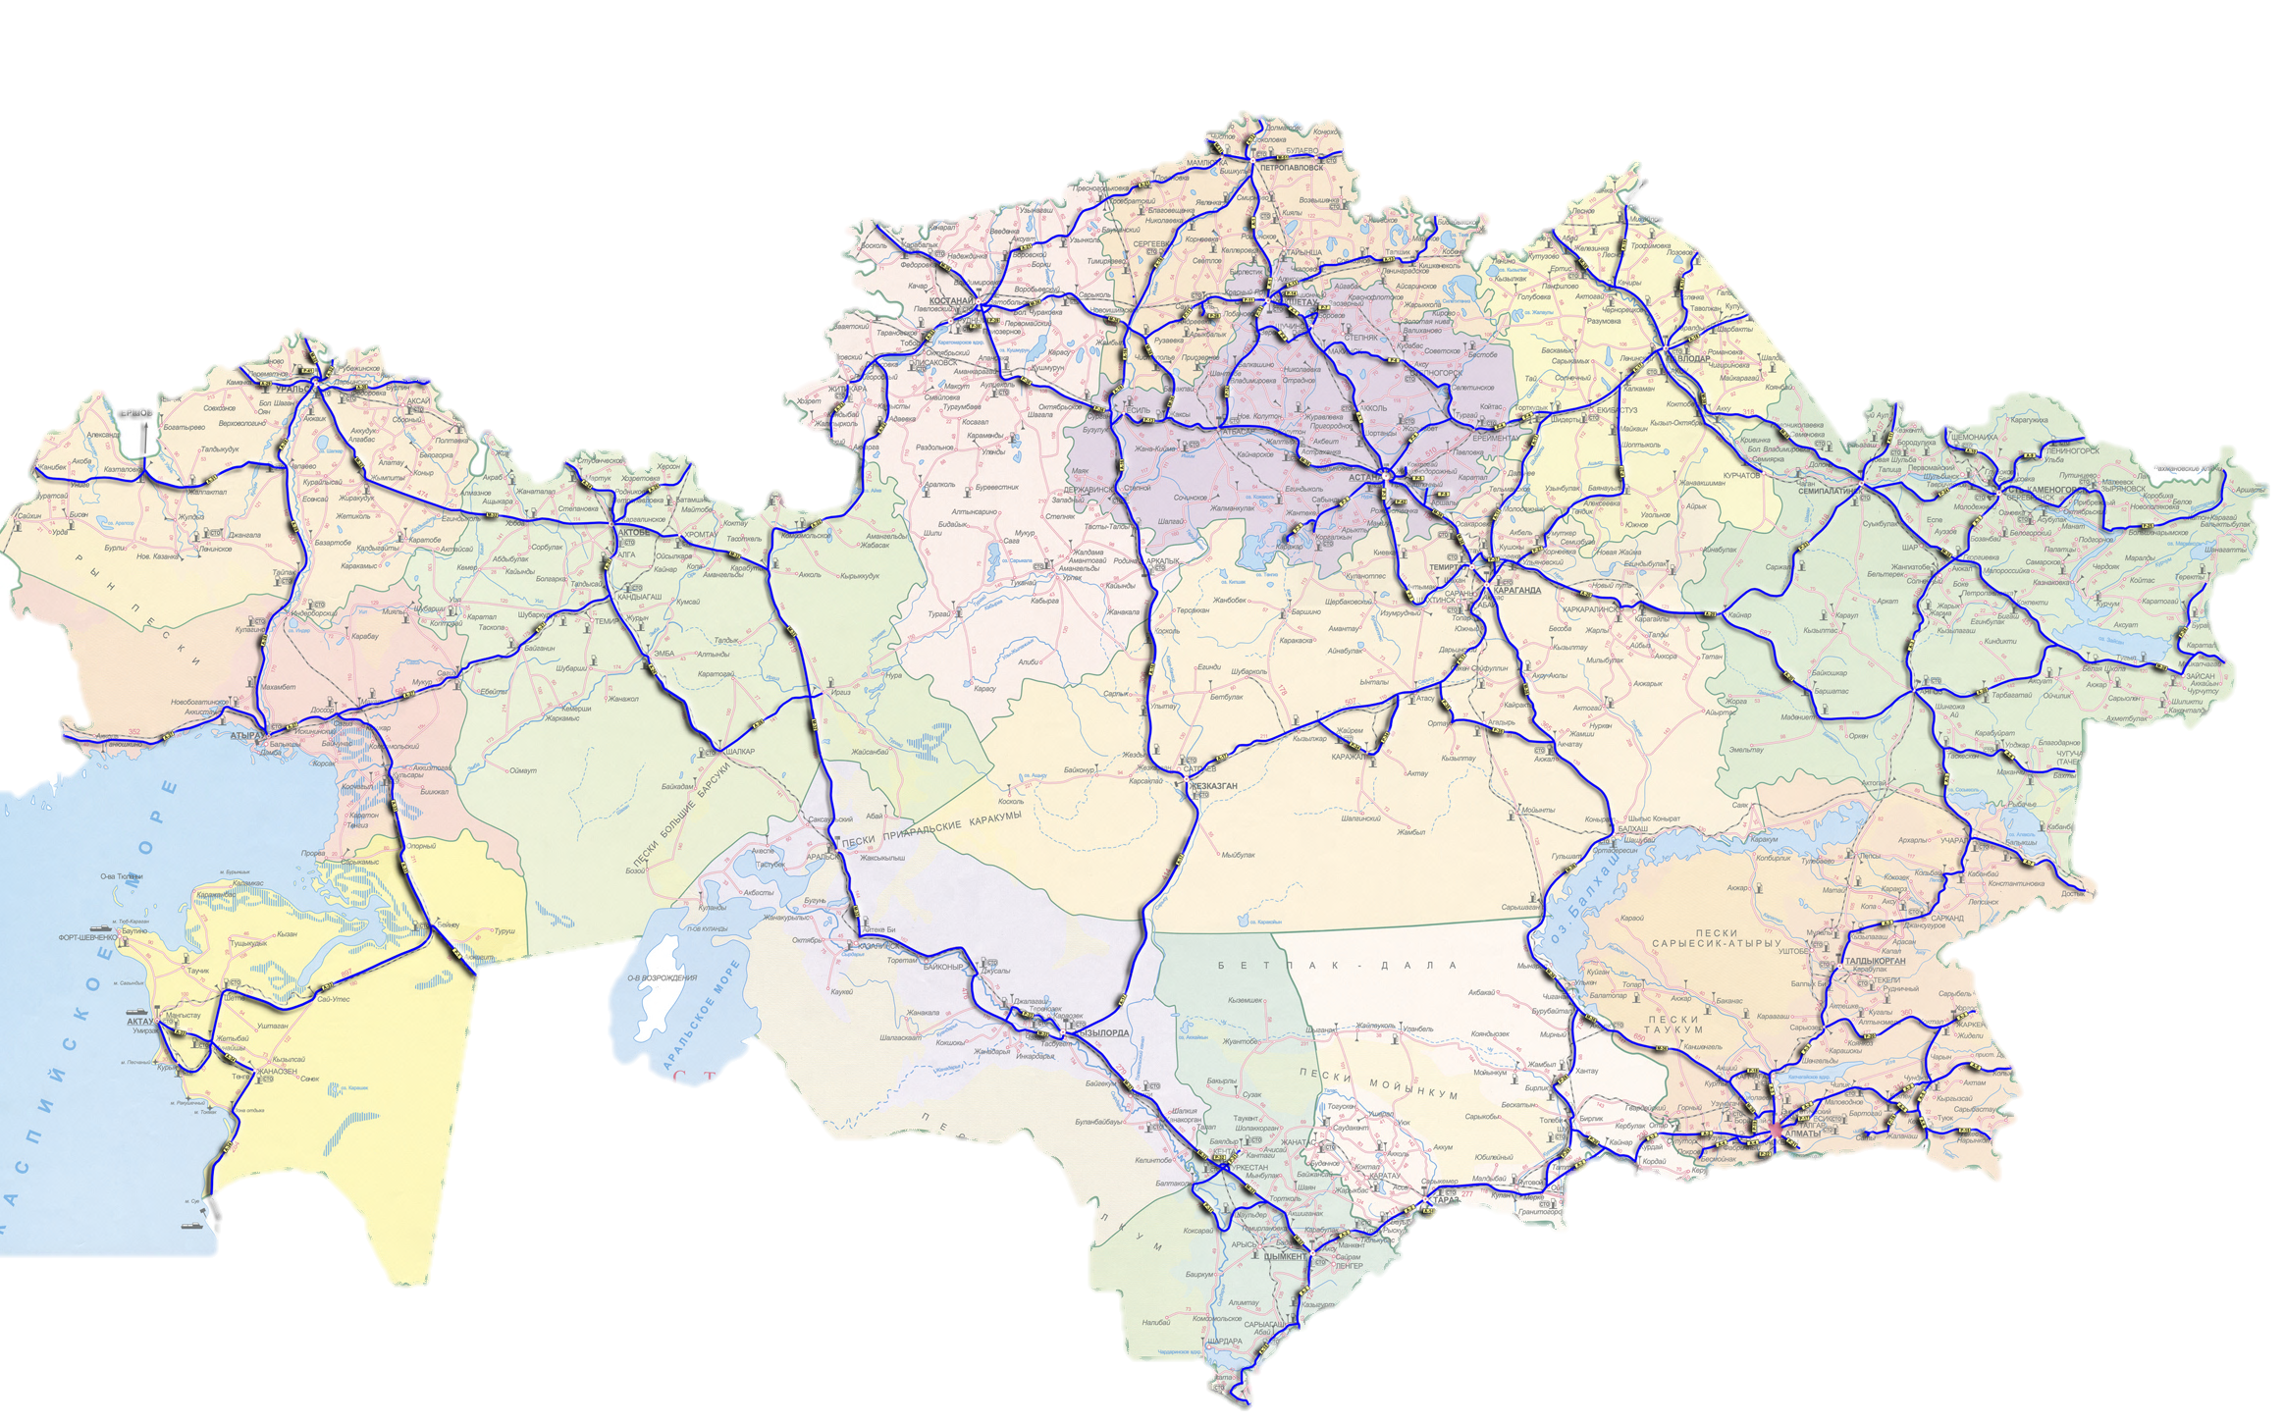
“WESTERN EUROPE – WESTERN CHINA” Project
Main Project Indicators
Project implementation
In 2011 – 215 km
Total Project Cost– 825,1 bln. KZT.
Length– 2 787 km
Incl. subject to reconstruction – 2 452 km
1 Category (4-lanes) – 1391 km
2 Category (2-lanes) – 1061 km
Implementation period– 2009-2015 г.г.
In 2012 – 700 km
Till 2013 disbursed - 331, 01 bln. KZT.
Plan for 2013 – 806 km (131, 3 bln.KZT)
AKTOBE
Current status
2013 works in progress - 1 812 km
Incl. new sections - 383 km
( Almaty-Khorgos, Shymkent – border of Zhambyl oblast)
KYZYLORDA
ALMATY
60 Road building companies have been involved in the construction
- Involved - 35 thousand people
Mobilized-4,5 thousand of equipment
TARAZ
SHYMKENT
LEGEND
- completed till 2012.
- traffic opened in 2012.
- it is planned to open traffic in 2013.
- work commencement from 2013.
Notes:
1
1
1
1

